Slide 1

Sign in to the Zoom
Meeting ID: 936 3722 6665
Passcode: 179776
Lecture-21: Function
Zhongyue John Yang
Department of Chemistry
Data Science Institute
Vanderbilt University
DS-5220

Slide 2
Formative Assessment
Q 1 – What is the output?
a = []
for i in range(3):
if i == 1:
break
else: a.append(i)
print("Done")
print(a)
Q 2 – What is the output?
a = []
for i in range(3):
if i == 1:
continue
else: a.append(i)
print("Done")
print(a)
Q 3 – What is the output?
a = []
for i in range(3):
if i == 1:
pass
else: a.append(i)
print("Done")
print(a)
A.
Done
Done
Done
[0, 1, 2]
B.
Done
Done
[0, 2]
C.
Done
[0]
D.
Done
Done
Done
[0, 2]

Slide 3
Formative Assessment
Q 4 – What is the output?
x = 0
while (x < 100):
x+=2
print(x)
99
100
101
102
Q 5 –Write a Python while statement to create a list of integers that range from 50 to 100 (including 100 in the list).
L = []
i = 50
while i <= 100:
L.append(i)
i = i + 1
print(L)

Slide 4
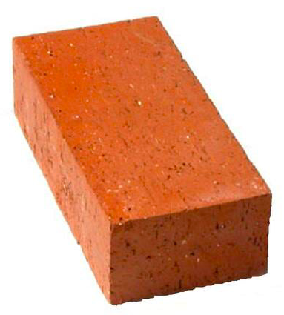
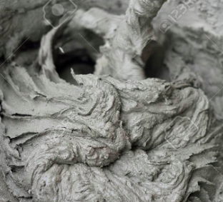
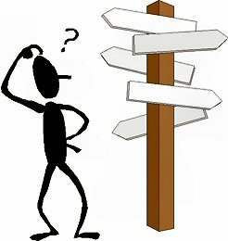
Overview: What Does it Take to Build a Program (House)?
Module–8
Module–9
Module–9
Module–10-11
Module–12-13
“Land”
Anaconda
Jupyter Notebook
“Rules”
Pythonic thinking
Basic syntax
“Bricks”
Operators
Variables
Built-in scalar types
Built-in data structures
“Cement”
Control flow
Iterators
List Comprehension
Functions
“Contractor team”
Modules and packages
NumPy
Pandas
Module–14-15
“You and your blueprint”
Errors and exceptions
Debugging
Object-oriented programming

Slide 5
Function: Avoid Repetition
One way to organize our Python code and to make it more readable and reusable is to factor-out useful pieces into reusable functions.
Think about the following scenario:
A = 3
B = 4
diff = abs(A - B)
print("The absolute difference between the two numbers is: " + str(diff))
A = 6
B = 7
diff = abs(A - B)
print("The absolute difference between the two numbers is: " + str(diff))
A = 5
B = 10
diff = abs(A - B)
print("The absolute difference between the two numbers is: " + str(diff))

Slide 6
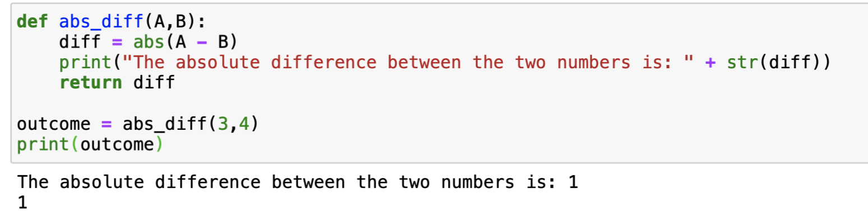
Function: Components
1. def keyword
2. function name
3. function arguments
4. function code
5. return statement

Slide 7
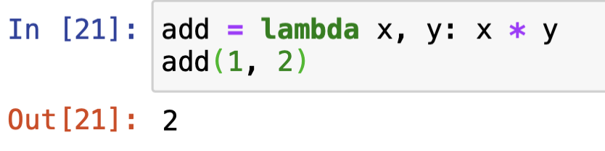
Anonymous Function: Lamda

Slide 8
Formative Assessment
Q 1 – What is the output of the following display() function call:
def display(*kwargs):
for i in kwargs:
print(i)
display("Kelly", 9000)
A.
Kelly
9000
B.
Kelly
C.
9000
D.
Error message
Q 2 – Given the following function fun1() Please select the correct function calls (select all that apply)
def fun1(name, age):
print(name, age)
A. fun1(name=’Emma’, age=23)
B. fun1(name=’Emma’, 23)
C. fun1(‘Emma’, 23)
D. fun1(‘Emma’, age = 23)

Slide 9
Formative Assessment
Q 3 – What is the output of the following function call:
def outerFun(a, b):
def innerFun(c, d):
return c + d
return innerFun(a, b)
return a
result = outerFun(5, 10)
print(result)

Slide 10
Formative Assessment
Q 4 – Choose the correct function declaration of fun1() so that we can execute the following function call successfully.
fun1(25, 75, 55)
fun1(10, 20)
Q 2 – What is the output of the following code snippet:
if 'bar' in {'foo': 1, 'bar': 2, 'baz': 3}:
print(1)
print(2)
if 'a' in 'qux':
print(3)
print(4)
A.
4
B.
1
2
4
C.
1
2
3
4
D. None of the above
A. def fun1(**kwargs)
B. No, it is not possible in Python
C. def fun1(args*)
D. def fun1(*data)
Q 5 – Python function always returns a value
True
False

